Slide 1
Pong frenzy
Geon Kim, Chanki Kong, Kevin Nguyen, Brandon Nguyen

Slide 2
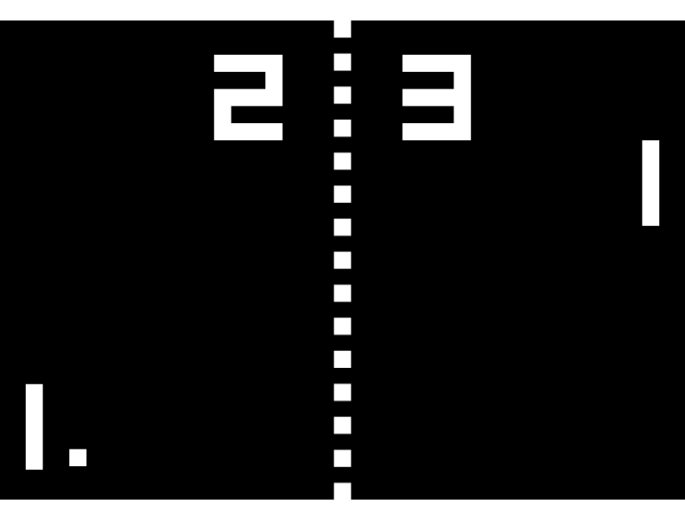
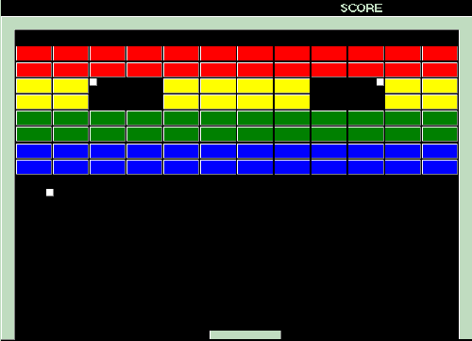
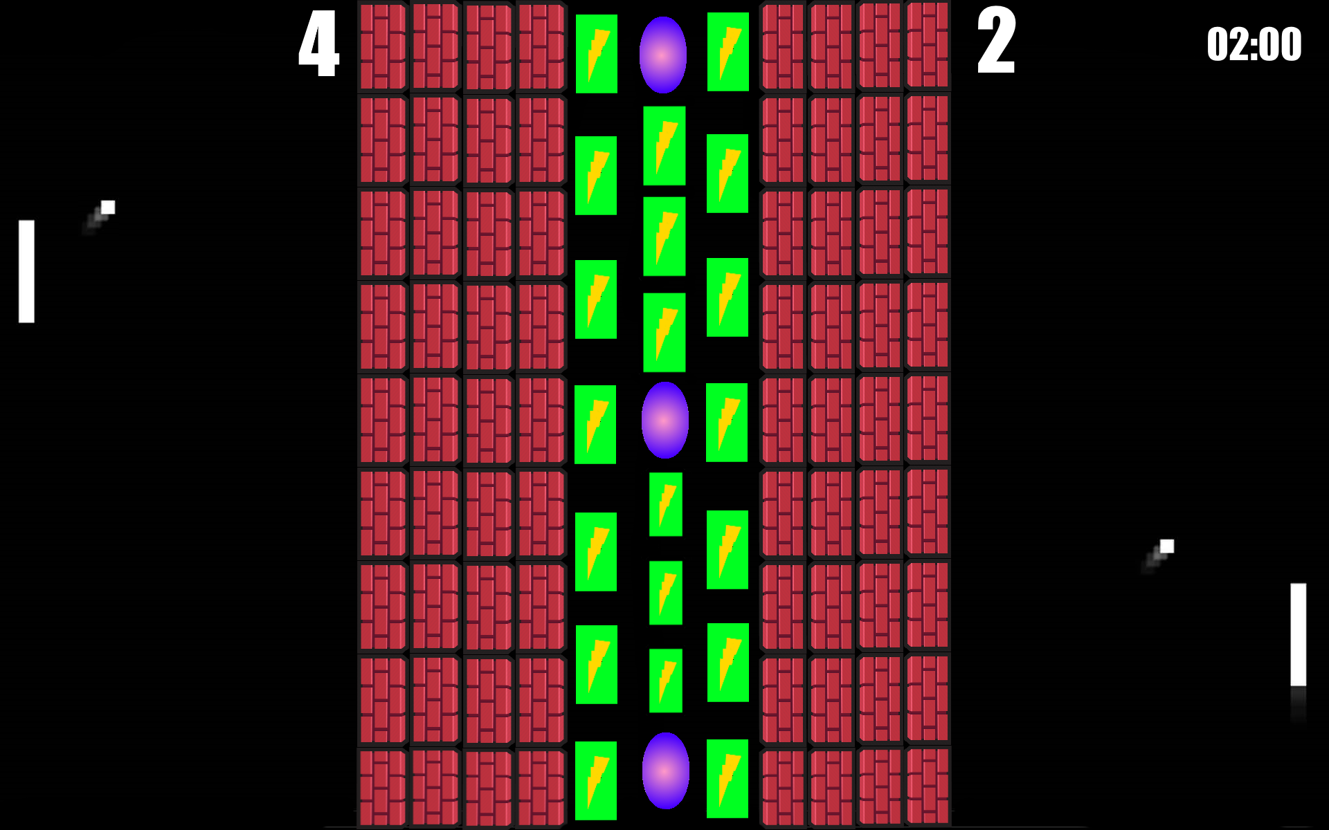
+
Pong + Brick breaker = Pong Frenzy
=

Slide 3
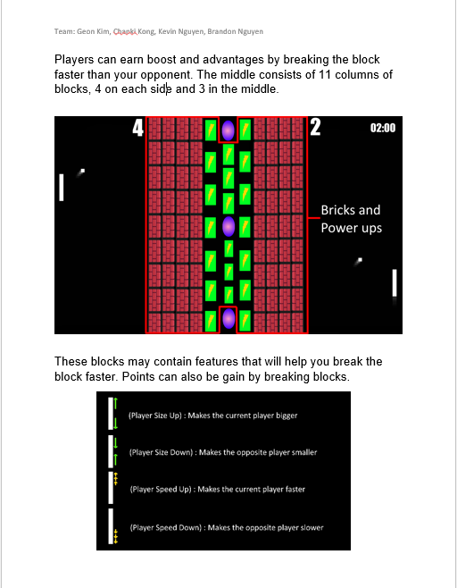
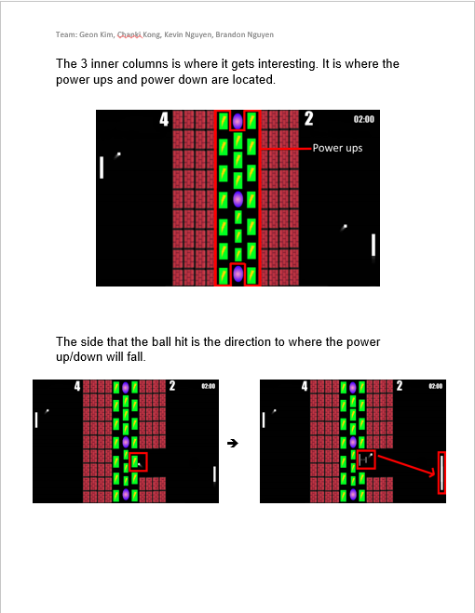
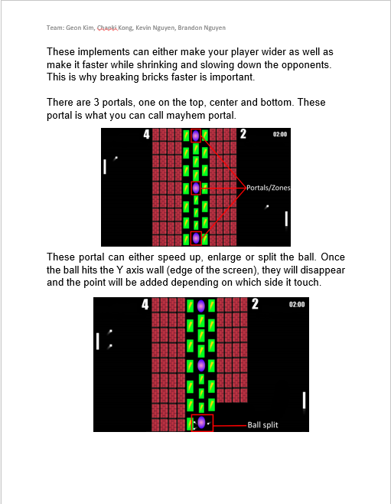
Game Design Document

Slide 4
Main Contributions
Brandon: Game design
Ball collisions
Music and sound effects
Score
Timer
Kevin: Players movement
Ball bouncing
Power ups drops
Player size down
Portals
Chanki: Ball speed up
Ball size up
Worlds transitions
Geon: Player size up
Player speed up
Player speed down

Slide 5
GAME DEMO

Slide 6
Qualities and Flaws
Good things: -overall, the game matches our expectations
-for the majority of the game, we were able to implement the math concepts
-extra time → added some things to make the game more entertaining
Bad things: -although the game looked quite simple, it had some complexity (it was harder than we thought)
-there were a lot of glitches and bugs → last minutes changes
-some implementations were too complex, so we had to change our game (power up that delays a player)

